Slide 1

Introduction to Unity
Animation System

Slide 2
Learning Objectives
Understand the role of animations in creating dynamic and engaging visuals.
Learn how to use the Unity Animation System to bring characters and objects to life.
Gain hands-on experience in creating basic animations.
Notes:
Online tutorial for this lesson:
https://www.youtube.com/watch?v=b0O2CRSdiOA&list=PLX2vGYjWbI0S-LEFR59E2B347w2HbjiJv
https://docs.unity3d.com/Manual/AnimationOverview.html

Slide 3
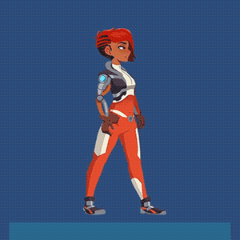
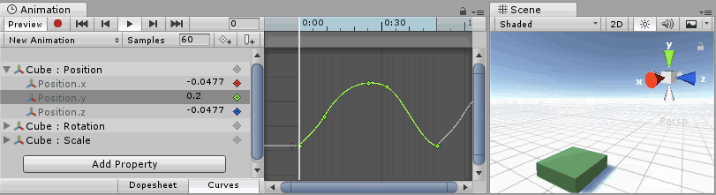
Overview of Animation in Unity
Animation serves as a cornerstone in game design, breathing life and dynamism into virtual worlds. It's the art of movement, transforming static elements into vibrant, interactive experiences.
2D Animation
3D Animation
Image source: Unity.com
Notes:
Image source:
https://blog.unity.com/engine-platform/getting-started-with-2d-inverse-kinematics
https://docs.unity3d.com/Manual/animeditor-AnimationCurves.html

Slide 4
Unity Animation System
Unity has two animation systems with different capabilities and performance characteristics:
Unity’s animation system, also known as Mecanim, is a rich and sophisticated animation system. It uses the Animator component, the Animation window, and the Animator window. The remaining sections of this page describe this system.
Unity’s Legacy Animation system has a smaller feature set. It uses the Animation component and was the only animation system available before Unity 4.
Notes:
Two different components for animating in Unity:
1. Legacy Animation: directly access the clips in the Animation and call play/stop
2. Mecanim (or called Animator): animation sets in a state machine.

Slide 5
Unity Animation System Basics
Animations are premade sets of visual motions. In a 2D game, this involves having several sequential images that can be flipped through very quickly. The result is that the object appears to be moving. This effect is similar to an old-fashioned flip book.
Animation in a 3D world is much different. In 3D games, you use models to represent your game entities. You cannot simply switch between models to give the illusion of motion. Instead, you have to actually move the parts of the model. Doing so requires both a rig and an animation.
3: Geig, Mike, Sams teach yourself Unity Game development in 24 hours, 2014

Slide 6
Features of Unity Animation System
Easy workflow and setup of animations for all elements of Unity including objects, characters, and properties.
Support for imported animation clips and animation created within Unity
Humanoid animation retargeting - the ability to apply animations from one character model onto another.
Simplified workflow for aligning animation clips.
Convenient preview of animation clips, transitions and interactions between them.
Management of complex interactions between animations with a visual programming tool.
Animating different body parts with different logic.
Layering and masking features

Slide 7
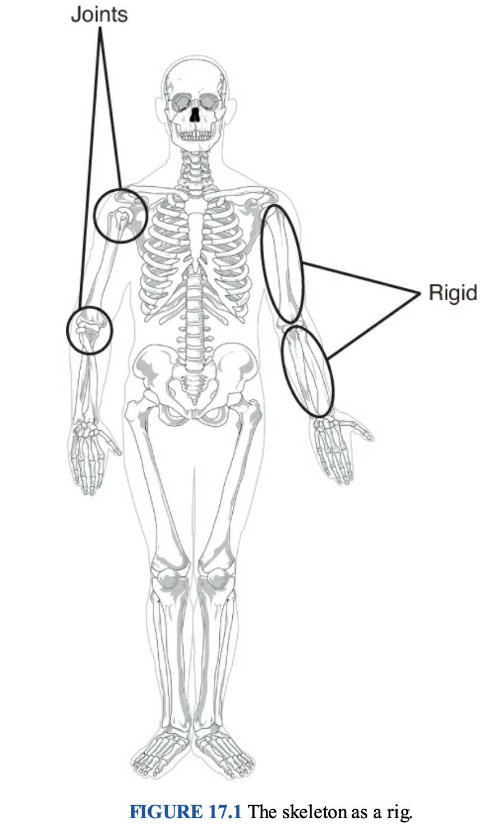
Animation Basics – The Rig
Animating a model without a rig is impossible (or impossibly difficult). The reasonis that without a rig, the computer has no way of knowing which parts of a model are supposed to move and how they are supposed to move. So, what exactly is a rig? Muchlike a human skeleton (see Figure 17.1), the rig dictates the parts of a model that are rigid, which are often called bones. It also dictates which parts can bend. These bendable parts are called joints.
3: Geig, Mike, Sams teach yourself Unity Game development in 24 hours, 2014

Slide 8
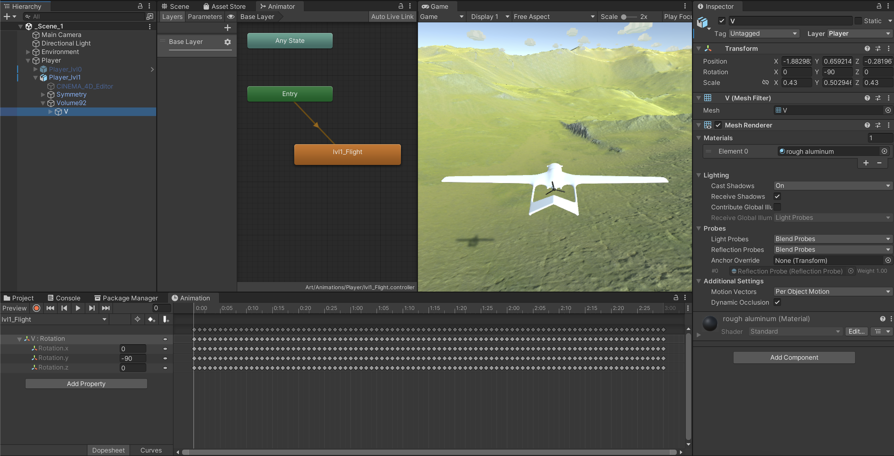
Animation and Animator Window
Notes:
Slide 6,7,8,9 nói qua về các màn hình (windows) khi làm việc với animation

Slide 9
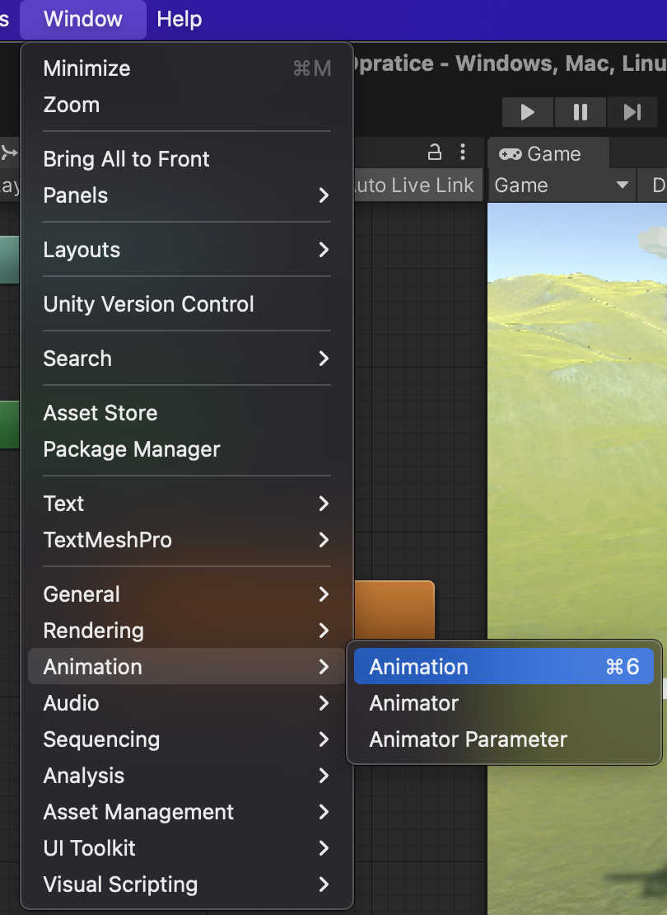
Animation and Animator Window
To add the Animation Window and Animator Window to your workspace in Unity:
Animation Window:
Menu Bar: Go to Window in the top menu.
Animation: Select Animation from the list.
Animator Window:
Menu Bar: Similarly, go to Window.
Animator: Choose Animator from the options.
Once selected, these windows will appear on your Unity workspace, allowing easy management and control of animations and animator controllers.

Slide 10
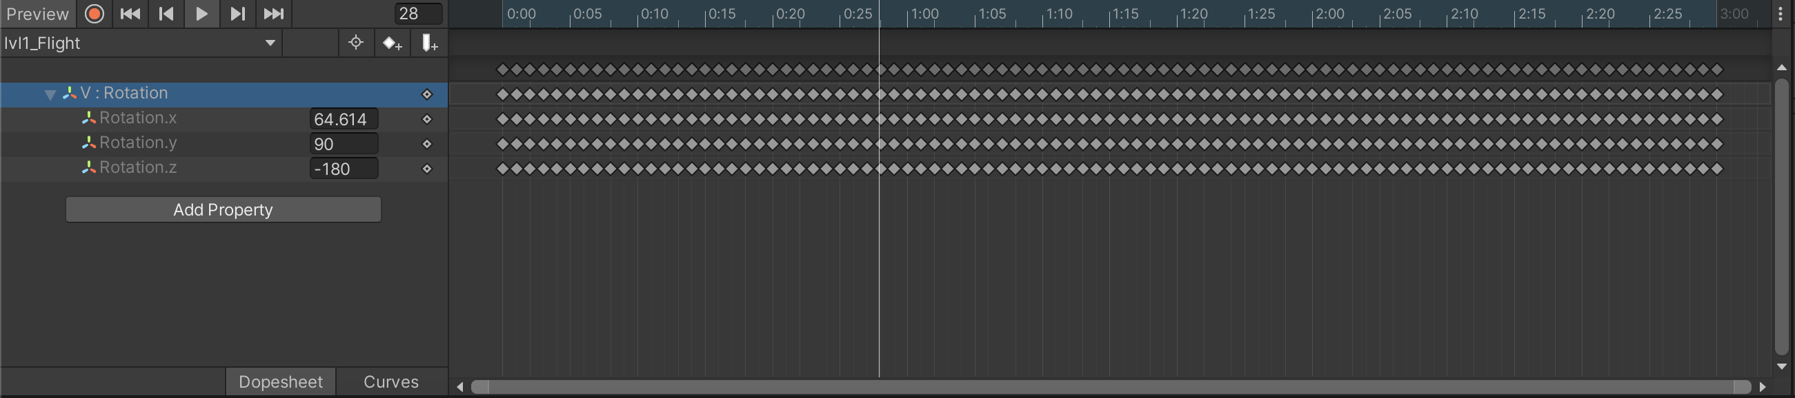
Animation Window
The Animation Window in Unity serves to create, edit, and manage animations for game objects. It provides a workspace to set keyframes, define motion, and effects for various elements, from characters to objects and even environmental elements.

Slide 11
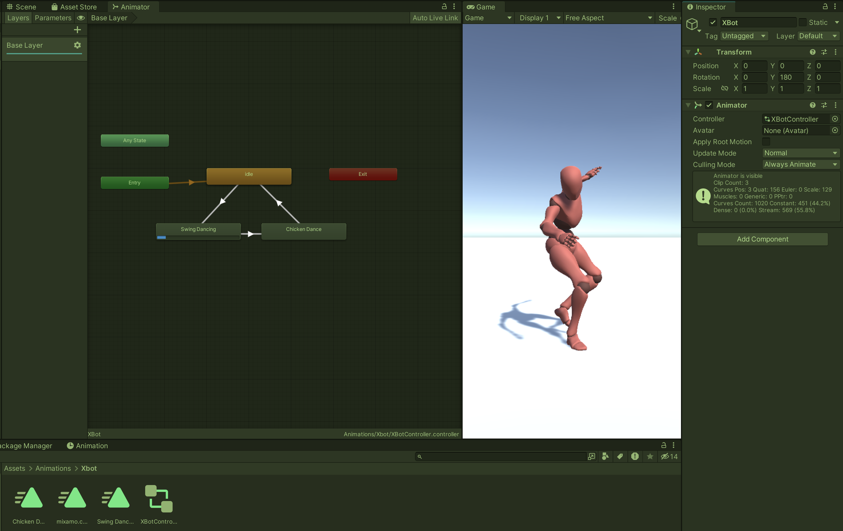
Animator Window
The Animator Window is used to create and manage Animator Controllers. These controllers manage the states and transitions between animations. It allows defining the logic for how animations are triggered and switched based on conditions and events within the game.
Notes:
https://docs.unity3d.com/Manual/AnimatorWindow.html

Slide 12
Animation Components
The heart of the animation system is composed of two kinds of assets: animation clips and animator controllers.
Notice animation versus animator clips are the individual animation loops to play, whereas the controller is the network controlling when to play animations. This network is a state machine diagram, and the states in the diagram are different animations that could be playing. The controller shifts between states in reaction to conditions it is watching, and plays a different animation in each state. ^{[1]}
8: Unity Technologies, Unity Manual, 2023
Notes:
https://docs.unity3d.com/Manual/class-Animator.html
https://docs.unity3d.com/Manual/AnimationClips.html

Slide 13
Animation Components
Animator Component
Animation clips
Animator Controller

Slide 14
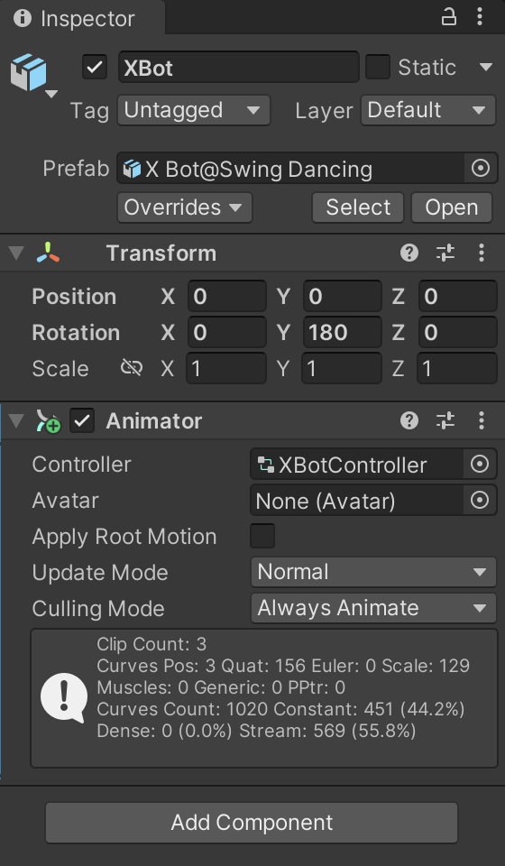
Animator component
Use the Animator component to assign animation to a GameObject in your Scene. The Animator component requires a reference to an Animator Controller which defines which animation clips to use, and controls when and how to blend and transition between them.
Notes:
https://docs.unity3d.com/Manual/class-Animator.html

Slide 15
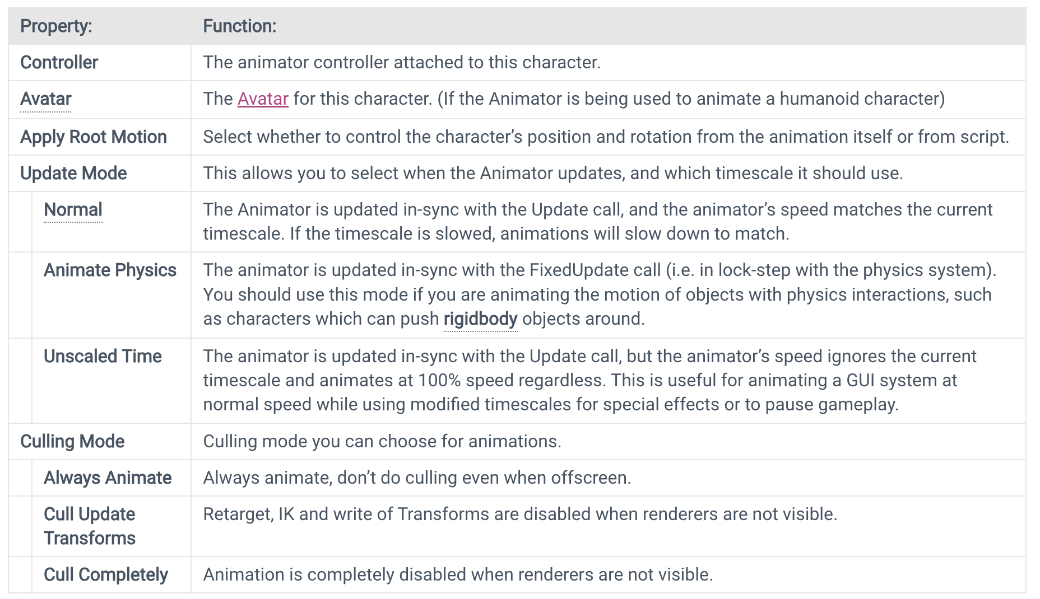
Animator component
8: Unity Technologies, Unity Manual, 2023
Notes:
https://docs.unity3d.com/Manual/class-Animator.html
Animator component
Animator component

Slide 16
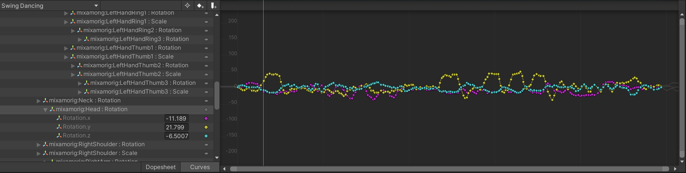
Keyframe Animation
A keyframe in Unity represents a specific point in time within an animation timeline. It defines the precise values of an object's properties, such as position, rotation, or scale, at that particular moment. These keyframes act as markers that determine the object's state or movement at different points in the animation, allowing for smooth transitions and defining the animation's flow.
The image illustrates the head rotation transformation during XBot's Swingdance animation
8: Unity Technologies, Unity Manual, 2023

Slide 17
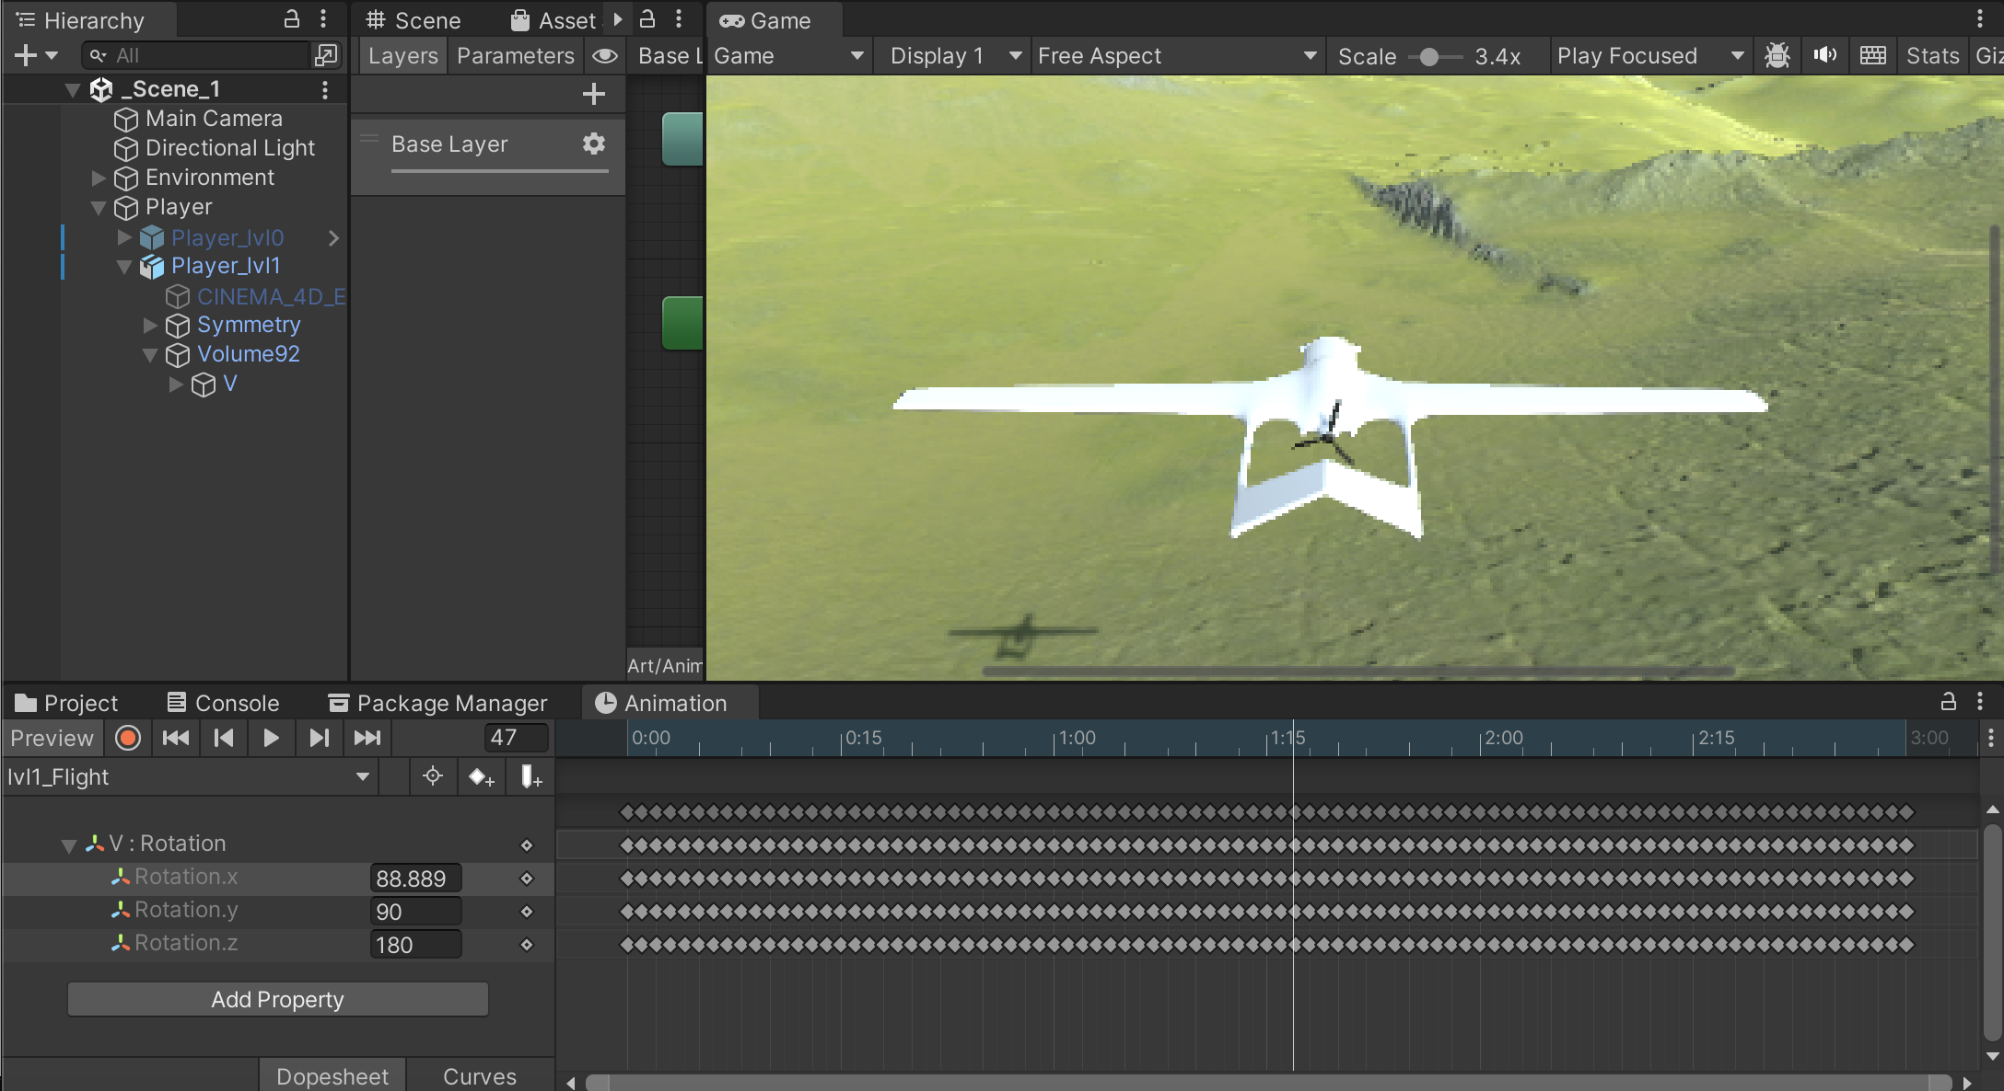
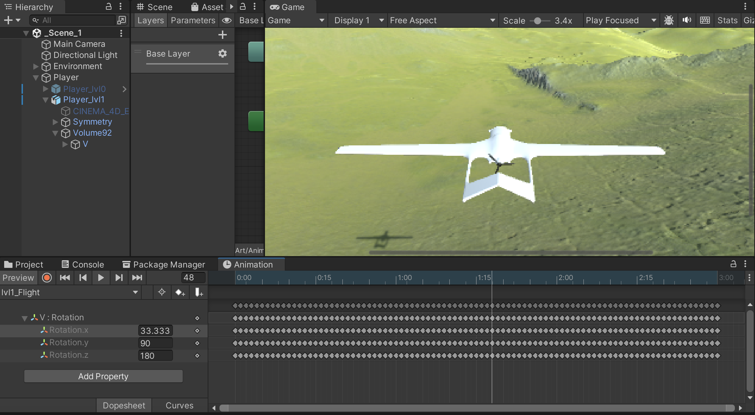
Keyframe Animation
For instance, when creating an animation for an airplane propeller, keyframes are generated at various positions of the propeller. At each of these points, the rotation value along the x, y and z-axis changes accordingly.
Use “Go to next keyframe” to check the animation’s keyframe

Slide 18
Animator Controller
An Animator Controller allows you to arrange and maintain a set of animations for a character or other animated Game Object.
The controller has references to the animation clips used within it, and manages the various animation states and the transitions between them using a so-called State Machine, which could be thought of as a kind of flow-chart, or a simple program written in a visual programming language within Unity.
8: Unity Technologies, Unity Manual, 2023
Notes:
https://docs.unity3d.com/Manual/class-AnimatorController.html

Slide 19
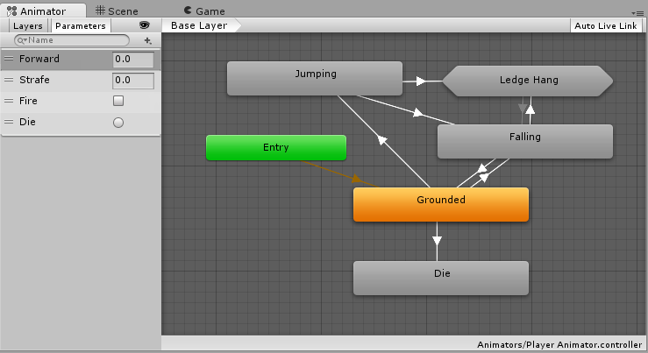
Animator Controller
For example, you could switch from a walk Animation Clip to a jump Animation Clip whenever the spacebar is pressed.
However even if you only have a single Animation Clip you still need to place it into an Animator Controller to use it on a GameObject.
8: Unity Technologies, Unity Manual, 2023

Slide 20
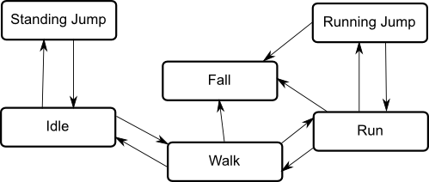
Animator Controller – State Machine
The basic idea is that a character is engaged in some particular kind of action at any given time. The actions available will depend on the type of gameplay but typical actions include things like idling, walking, running, jumping, etc. These actions are referred to as states, in the sense that the character is in a “state” where it is walking, idling or whatever. In general, the character will have restrictions on the next state it can go to rather than being able to switch immediately from any state to any other.
The options for the next state that a character can enter from its current state are referred to as state transitions.
The states and transitions of a state machine can be represented using a graph diagram, where the nodes represent the states and the arcs (arrows between nodes) represent the transitions.
8: Unity Technologies, Unity Manual, 2023
Notes:
An Overview of state machine in Unity
https://docs.unity3d.com/Manual/StateMachineBasics.html
For example, a running jump can only be taken when the character is already running and not when it is at a standstill, so it should never switch straight from the idle state to the running jump state.

Slide 21
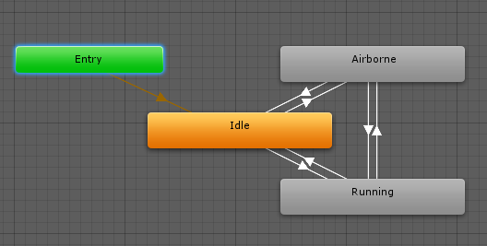
State Transitions
State Machine Transitions exist to help you simplify large or complex State Machines. They allow you to have a higher level of abstraction over the state machine logic.
Each view in the animator window has an Entry and Exit node. These are used during State Machine Transitions.
Because state machines always have a default state, there will always be a default transition branching from the entry node to the default state.
8: Unity Technologies, Unity Manual, 2023
Notes:
https://docs.unity3d.com/Manual/StateMachineTransitions.html
The Entry node is used when transitioning into a state machine. The entry node will be evaluated and will branch to the destination state according to the conditions set. In this way the entry node can control which state the state machine begins in, by evaluating the state of your parameters when the state machine begins.

Slide 22
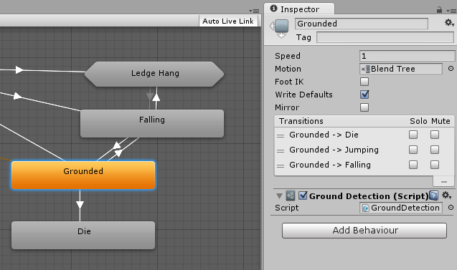
State Machine Behaviours
A State Machine Behaviour is a special class of script. In a similar way to attaching regular Unity scripts (MonoBehaviours) to individual GameObjects, you can attach a StateMachineBehaviour script to an individual state within a state machine. This allows you to write code that will execute when the state machine enters, exits or remains within a particular state. This means you do not have to write your own logic to test for and detect changes in state.
State Machine Behaviour scripts have access to a number of events that are called when the Animator enters, updates and exits different states (or sub-state machines). There are also events which allow you to handle the Root motion and Inverse Kinematics calls.
8: Unity Technologies, Unity Manual, 2023
Notes:
https://docs.unity3d.com/Manual/StateMachineBehaviours.html
State Machine Behaviours can be created and added to states in a very similar way to the way you would create and add scripts to GameObjects. Select a state in your state machine, and then in the inspector use the “Add Behaviour” button to select an existing StateMachineBehaviour or create a new one.
A few examples :
Play sounds as states are entered or exited
Perform certain tests (eg, ground detection) only when in appropriate states
Activate and control special effects associated with specific states
Ref script
https://docs.unity3d.com/ScriptReference/StateMachineBehaviour.html

Slide 23
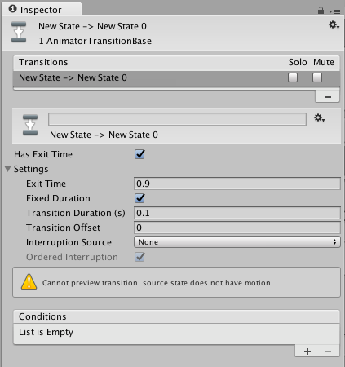
Unity Animation transitions
Animation transitions allow the state machine to switch or blend from one animation state to another. Transitions define not only how long the blend between states should take, but also under what conditions they should activate. You can set up a transition to occur only when certain conditions are true. To set up these conditions, specify values of parameters in the Animator Controller.
8: Unity Technologies, Unity Manual, 2023
Notes:
https://docs.unity3d.com/Manual/class-Transition.html

Slide 24
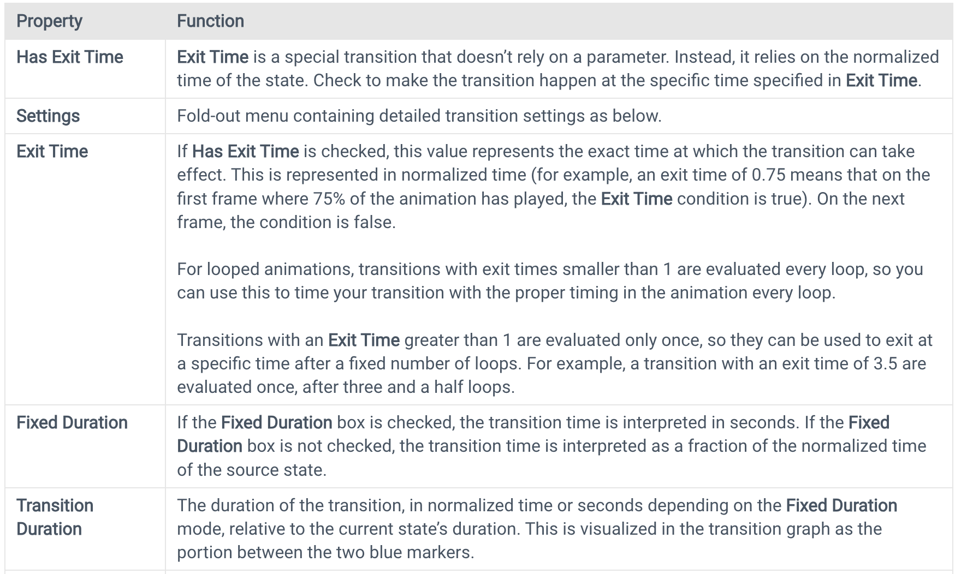
Transition properties
8: Unity Technologies, Unity Manual, 2023

Slide 25
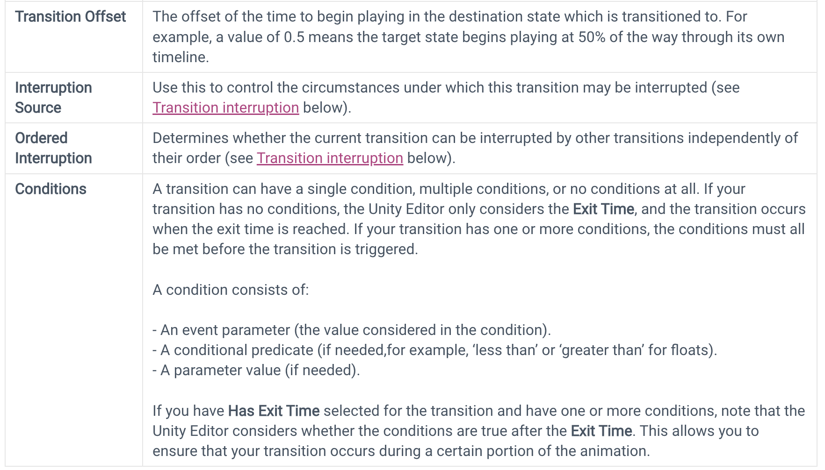
Transition properties
8: Unity Technologies, Unity Manual, 2023

Slide 26
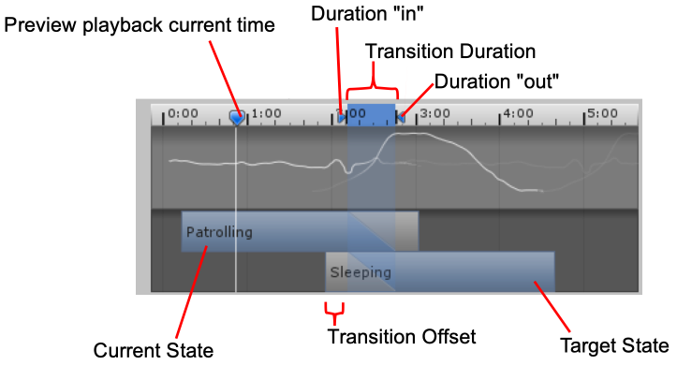
Transition graph
To manually adjust the settings listed above, you can either enter numbers directly into the fields or use the transition graph. The transition graph modifies the values above when the visual elements are manipulated.
8: Unity Technologies, Unity Manual, 2023
Notes:
https://docs.unity3d.com/Manual/class-Transition.html

Slide 27
Blend Trees
A blend tree in Unity's Mecanim animation system allows seamless blending between multiple animations based on specified parameters. It's a versatile tool used to smoothly transition animations, like character movements, depending on predefined conditions or input values such as speed or direction. This enables the creation of more natural and responsive character animations.
A common task in game animation is to blend between two or more similar motions. Perhaps the best known example is the blending of walking and running animations according to the character’s speed. Another example is a character leaning to the left or right as it turns during a run.
8: Unity Technologies, Unity Manual, 2023
Notes:
https://docs.unity3d.com/Manual/class-BlendTree.html

Slide 28
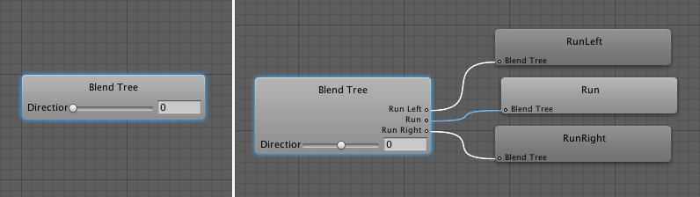
Blend Trees
To start working with a new Blend Tree, you need to:
Right-click on empty space on the Animator Controller Window.
Select Create State > From New Blend Tree from the context menu that appears.
Double-click on the Blend Tree to enter the Blend Tree Graph.
8: Unity Technologies, Unity Manual, 2023

Slide 29
Blend Trees vs Transition
It is important to distinguish between Transitions and Blend Trees. While both are used for creating smooth animation, they are used for different kinds of situations.
Transitions are used for transitioning smoothly from one Animation State to another over a given amount of time. Transitions are specified as part of an Animation State Machine. A transition from one motion to a completely different motion is usually fine if the transition is quick.
Blend Trees are used for allowing multiple animations to be blended smoothly by incorporating parts of them all to varying degrees. The amount that each of the motions contributes to the final effect is controlled using a blending parameter, which is just one of the numeric animation parameters associated with the Animator Controller. In order for the blended motion to make sense, the motions that are blended must be of similar nature and timing. Blend Trees are a special type of state in an Animation State Machine.
8: Unity Technologies, Unity Manual, 2023

Slide 30
Exercise: Basic Animation Setup
With the aim of understanding the workings of Unity Animation, this exercise will be divided into two parts:
Using Adobe Mixamo models to create a dancing robot.
Creating a custom animation based on the previously crafted 3D objects.
8: Unity Technologies, Unity Manual, 2023
Notes:
Students need to follow the next slide's instructions to practice with Unity.
Practice Resources sharing:
https://drive.google.com/drive/folders/1eXu20cX1o-5uMFuSeHGxRS5AkhDZJTOP?usp=sharing
For lecturer: open file in: ./LO.3-Animations-and-Physics/Lecturer-Guide/3.1_Animation-System.mp4
And user Assets file in ./LO.3-Animations-and-Physics/Lecturer-Guide/Assets/3.1_Animation-System/*
To create the final project.

Slide 31
Exercise A: Using Adobe Mixamo model
Download the X Bot model and "Swing dancing" animation from Adobe Mixamo in FBX.
Import the model and animation into Unity.
Create a new Animator Controller in the Animator window.
Add an Animator component to the X Bot.
Test the "Swing dancing" animation on the X Bot in the scene.

Slide 32
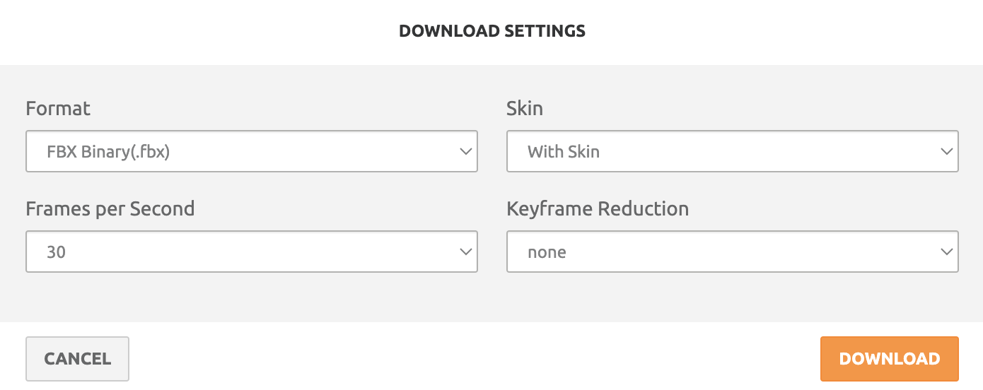
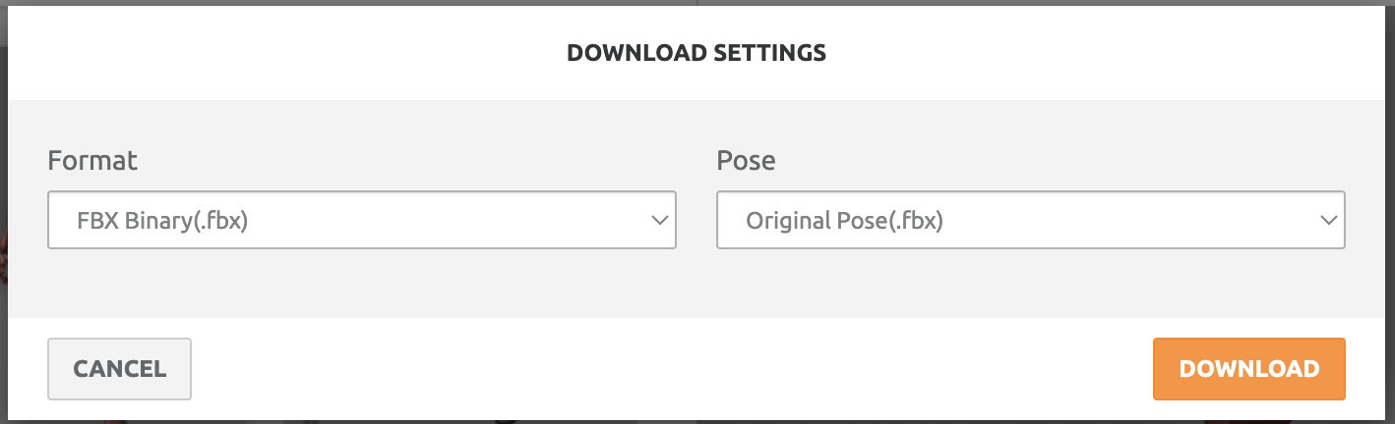
Exercise A: Using Adobe Mixamo model
1. Download the X Bot model and "Swing dancing" animation from Adobe Mixamo in FBX
Go to https://www.mixamo.com/ site, select character (ex: xbot), and select Animation (ex: Swing Dancing).
Click download and fill form with below informations
Download character in mixamo
Download Animation of the character in mixamo
Notes:
https://www.mixamo.com/#/?page=1&query=swing+dancing&type=Motion%2CMotionPack

Slide 33
Exercise A: Using Adobe Mixamo model
2. Import the model and animation into Unity.
Drag and drop the model file (X Bot) directly into the "Assets" folder in the Unity Editor to import the model into your project.
Similarly, drag and drop the animation file ("Swing dancing") into the "Assets" folder for Unity to import it separately.
Once imported, access the model and animation files within the "Assets" folder in the Unity Editor's project window.
To use the imported model in your scene, drag and drop it from the "Assets" folder into the Scene view or Hierarchy window, creating a GameObject with the imported model in your scene.

Slide 34
Exercise A: Using Adobe Mixamo model
3. Create a new Animator Controller in the Animator window.
Create Animator Controller: In project panel, Assets folder, right-click and select Create > Animator Controller. Rename it (e.g., "XBotAnimatorController").
Add Swing Dancing Animation: Drag the "Swing dancing" animation clip from Assets to the Animator Controller area to create a new state.
Create Transition to Swing Dance: Right-click on the "Idle" state, select "Make Transition," then drag and release the arrow on the "Swing dancing" state to create a transition.
Add Transition Conditions: Click on the transition arrow, in the Inspector, add conditions (like parameters or triggers) to activate the transition.
Create Return Transition: Similarly, create a transition from "Swing dancing" state back to "Idle" state, adding conditions if needed.

Slide 35
Exercise A: Using Adobe Mixamo model
4. Add an Animator component to the X Bot.
Select the X Bot GameObject in the Unity Editor.
Click "Add Component" in the Inspector.
Type and select "Animator" from the list.
Drag the ‘XBotAnimatorController’ (containing the "Swing dancing" animation) to the Animator component.
Configure animation transitions and parameters as needed within the Animator Controller.

Slide 36
Exercise A: Using Adobe Mixamo model
5. Test the "Swing dancing" animation on the X Bot in the scene..
Click Play in Game View: click on the Play button in the Unity Editor's Game View.
Observe Animation in Scene View: In the Scene view, locate your X Bot. Observe its movements in the scene to ensure it's performing the "Swing dancing" animation correctly.
Check Animation Transition in Animation Window: Open the Animation window. With the X Bot selected in the Hierarchy or Scene view, inspect the Animation window to observe the transition from the 'Idle' animation state to 'Swing dancing' and vice versa. Verify that the transition occurs smoothly without any glitches or interruptions.

Slide 37
Exercise B: Create a simple animation
Create an animation for the airplane wing to rotate 15 degrees during takeoff.
The animation will last for 1 second. During this time, the airplane wing will rotate along the X-axis.
Steps to create:
In the Hierarchy window, select AirplaneWing object. Open the Animation window and click on Create button. Enter the animation name as ThrottleUpAnimation.
In the Animation window, select Add Property > Transform > Rotate.
Create keyframes for the effect by entering the following values (only change Rotation.x; y & z remain default: 0):
60 (1 second): Rotation.x = -15
15 (1/4 second): Rotation.x = -3.75
30 (1/2 second): Rotation.x = -7.5
45 (3/4 second): Rotation.x = -11.25

Slide 38
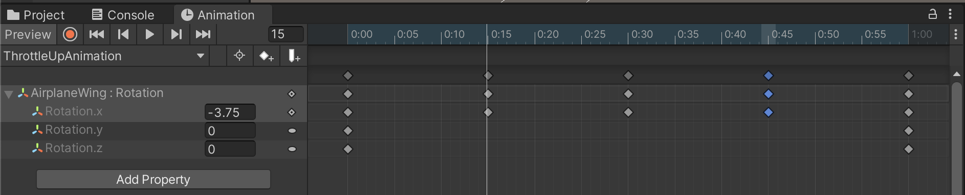
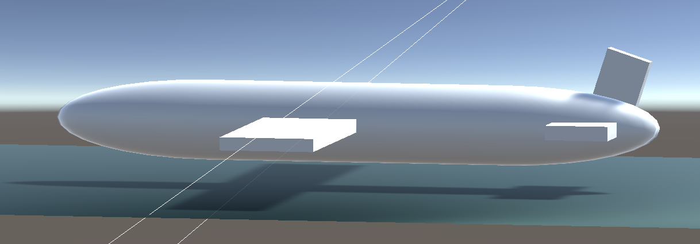
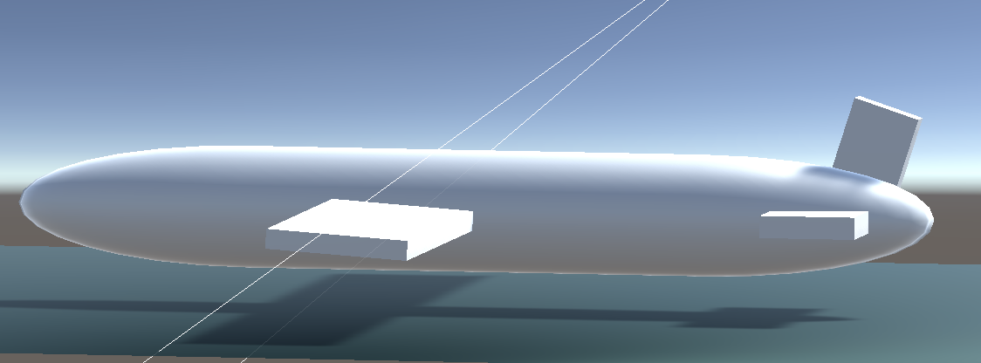
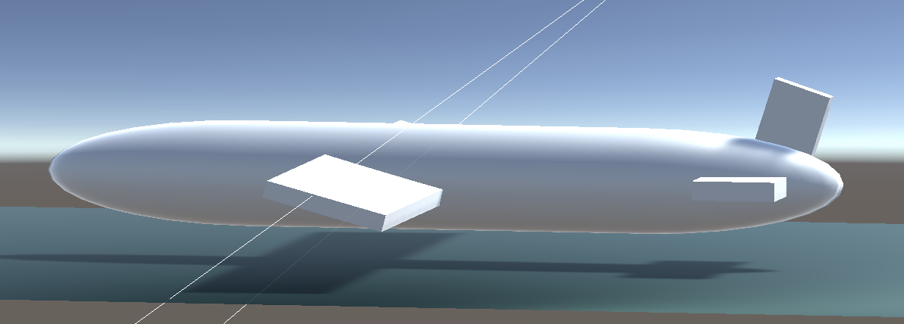
Exercise B: Create a simple animation
8: Unity Technologies, Unity Manual, 2023

Slide 39
Summary
Importance of animation in Unity game development, emphasizing fundamental learning objectives.
Understanding animation's role in enhancing visual appeal and user experience.
Overviewing Unity's Animation System basics, including Animation window and components.
Essential explanation of Animator, Animation Controller, and Animation Clips components.
Introduction to keyframe animation creation and practical examples.
Comprehensive exploration of the Animator Controller and its animation flow control.
Understanding state transitions within the Animator Controller, demonstrated with smooth transition examples.
Introducing Blend Trees for complex animation variations and showcasing their usage in Unity.
Hands-on coding exercise to set up a basic animation, guided by instructors.

Slide 40
References
1: Hocking, Joseph; Schell, Jesse, Unity in action: multiplatform game development in C#, 2022
3: Geig, Mike, Sams teach yourself Unity Game development in 24 hours, 2014
8: Unity Technologies, Unity Manual, 2023
9: Tutorials Point, Learning Unity, 2023

